Slide 1
Bell work
What is electric current and what unit is it expressed in?

Slide 2
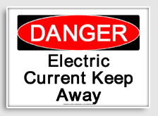
Electrical Currents and Energy PowerPoint By: Cameron Fox , Keishay Brown, Ella Abram, and Troy Hall

Slide 3
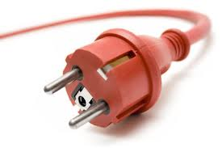
Objectives
Describe the two types of electric currents.
Understand how the thickness and the length of a wire affects it’s resistance.
Indicate what make charges move.
What is the difference between thermocouple and photocell?

Slide 4
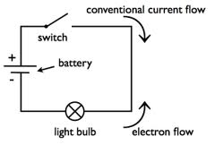
What are electric currents and electrical energy?
Electrical energy is the energy of electric charges.
Most things use electrical energy. The electric charges flow through wires.
Electric current is the rate at which charges pass a given point . The higher the current is the greater number of charges that pass the point each second.
Electric currents are expressed in the unit amperes. Which often shorten to amps. The symbol for amps is A. In equations the symbol for current is the letter I.

Slide 5
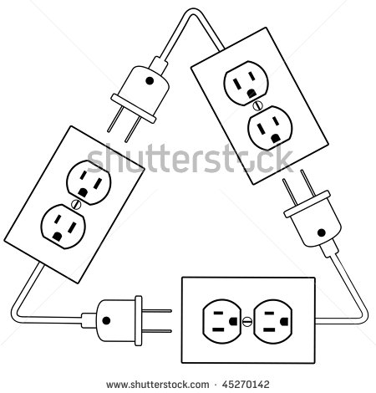
AC and DC
There are two kinds of electric currents, direct current and alternating currents . The direct current the charges flow in the same direction and alternating current the charges shift from one direction to the reverse direction.
Both currents give electrical energy.

Slide 6
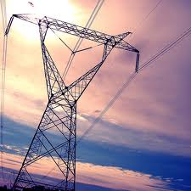
Voltage
Voltage is the potential difference between two points in a circuit. It’s expressed in volts .In equations the symbol is a letter V.

Slide 7
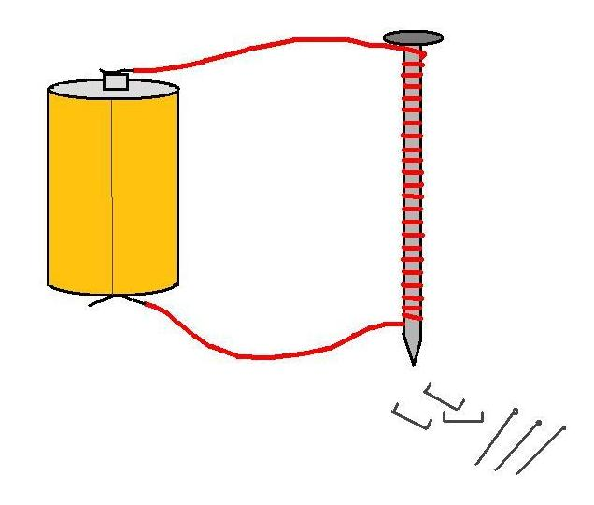
Resistance
Resistance is the opposition to the flow of electric charge. It’s expressed in ohms Ω, the Greek letter for omega. You can think resistance as electrical friction. An object’s resistance depends on the object’s material, thickness, length, and tempeture.

Slide 8
Resistance (continued)
Resistance also depends on tempeture. The resistance of metals increases as temperature rises. The atoms vibrate faster at higher temperatures and get in the way of the flowing electric charges. If you cool certain materials to a very low temperature, resistance will drop to 0Ω. Materials in this state are called superconductors.

Slide 9
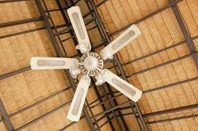
Generating Electrical Energy
Energy can’t be created or destroyed, but it can be changed into other kinds of energy. Many things change different types of energy into electrical energy. Cells change chemical or radiant energy into electrical energy. A cell contains a mixture of chemicals called electrolyte. Electrolytes allow charges to flow. Every cell has a pair of electrodes. An electrode is the part of a cell through which charges enter or exit.

Slide 10
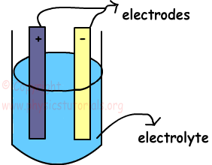
Generating Electrical Energy (continued)
There are two types of cells: wet and dry. Wet cells have liquid electrolytes. Wet cells use sulfuric acid. Dry cells also have electrolytes, but the electrolytes are solid.

Slide 11
Thermocouples
Thermal energy heat can be converted into electrical energy by a thermocouple. Thermocouples usually don’t generate much energy. But they are useful for monitoring the temperature of a car engines, furnaces, and ovens.

Slide 12
Photocells
A photocell converts light energy into electrical energy. Most photocells contain silicon atoms. The electrons are then able to move to provide electrical energy to power a device. In larger panels, photocells can provide energy to buildings and cars.

