Slide 1
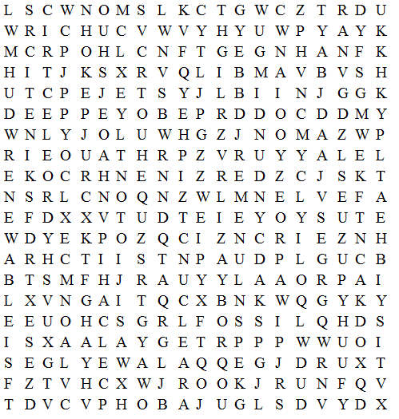
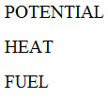
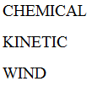
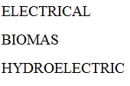
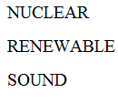
Use the highlighter or pen tool to find the words.

Slide 2
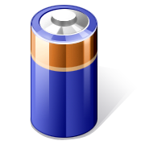
It’s Electric (and Other Energy) Review
SPI 0607.10.1 Distinguish among gravitational potential energy, elastic potential energy, and chemical potential energy.
SPI 0607.10.2 Interpret the relationship between potential and kinetic energy.
SPI 0607.10.3 Recognize that energy can be transformed from one type to another.
SPI 0607.10.4 Explain the Law of Conservation of Energy using data from a variety of energy transformations.
SPI 0607.12.1 Identify how simple circuits are associated with the transfer of electrical energy when heat, light, sound, and chemical changes are produced.
SPI 0607.12.2 Identify materials that can conduct electricity.
Science with Mrs. Williams

Slide 3
Potential and Kinetic Energy
Energy Transformations
Law of Conservation of Energy
Simple Circuits
Electrical Conduction
100
100
100
100
100
200
200
200
200
200
300
300
300
300
300
400
400
400
400
400
500
500
500
500
500

Slide 4
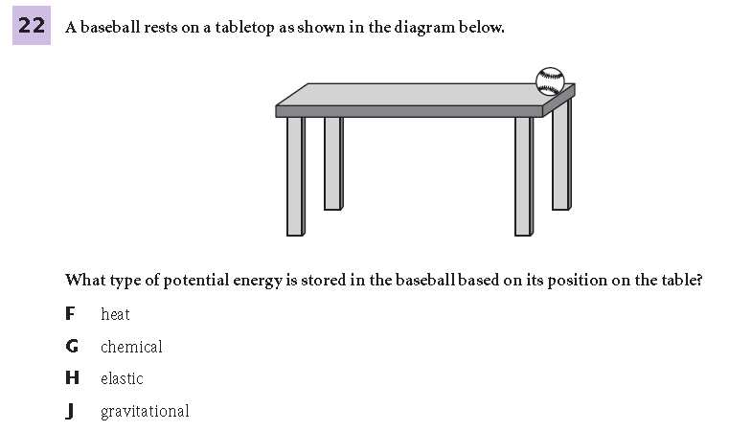
Potential and Kinetic Energy 100
Notes:
J

Slide 5
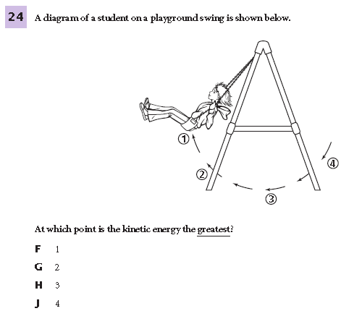
Potential and Kinetic Energy 200
Notes:
H

Slide 6
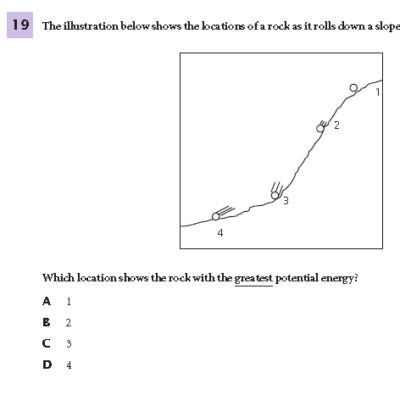
Potential and Kinetic Energy 300
Notes:
A

Slide 7
Potential and Kinetic Energy 400
Notes:
B

Slide 8
Potential and Kinetic Energy 500
Notes:
J

Slide 9
Energy Transformations 100
Notes:
D

Slide 10
Energy Transformations 200
Notes:
A

Slide 11
Energy Transformations 300
Notes:
H

Slide 12
Energy Transformations 400
Notes:
B

Slide 13
Energy Transformations 500
Notes:
J

Slide 14
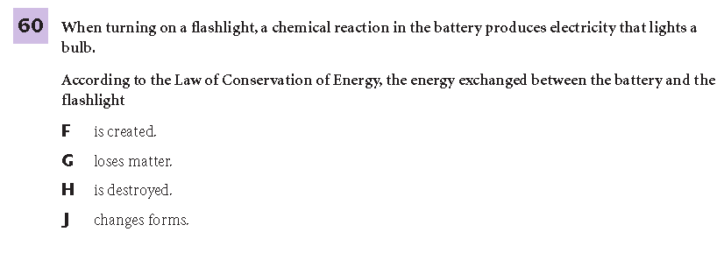
Law of Conservation of Energy 100
Notes:
J

Slide 15
Law of Conservation of Energy 200
Energy can be created and destroyed.
Energy cannot be created or destroyed.
Energy can be created but not destroyed.
Energy can be destroyed but not created.
Notes:
B

Slide 16
Law of Conservation of Energy 300
All the electrical energy is transformed to light energy and heat energy.
All the electrical energy is transformed to heat energy.
Some of the electrical energy is transformed to light energy and some is destroyed.
All the electrical energy is transformed to light energy.
Notes:
A

Slide 17
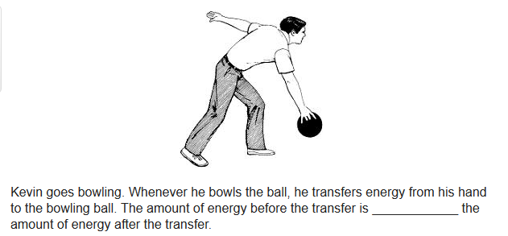
Law of Conservation of Energy 400
A. not related to C. less than
B. equal to D. more than
Notes:
B

Slide 18
Law of Conservation of Energy 500
conservation
transformation
stability
absorption
Notes:
A

Slide 19
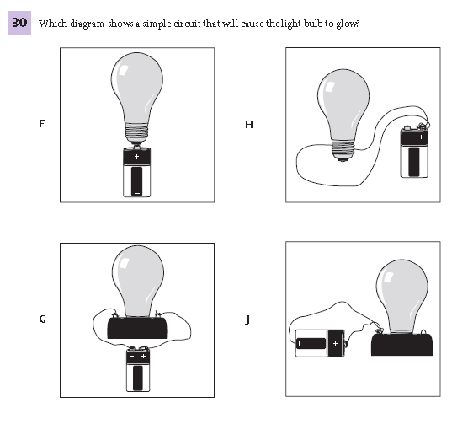
Simple Circuits 100
Notes:
G

Slide 20
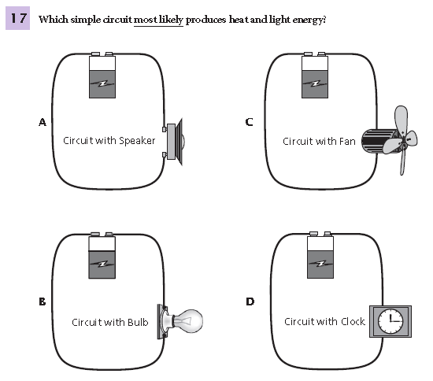
Simple Circuits 200
Notes:
B

Slide 21
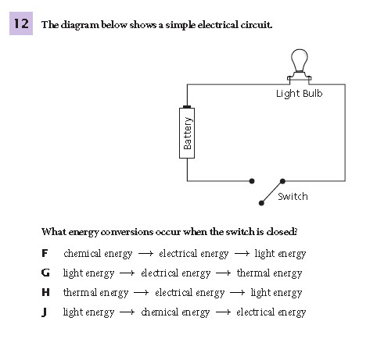
Simple Circuits 300
Notes:
F

Slide 22
Simple Circuits 400
Notes:
A

Slide 23
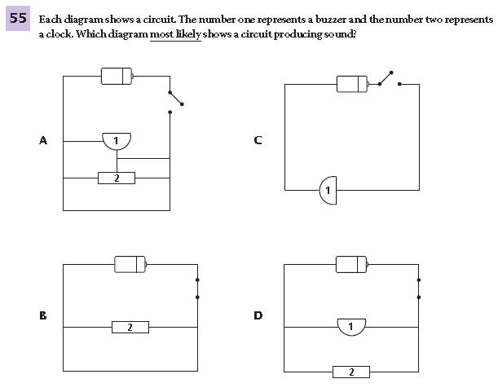
Simple Circuits 500
Notes:
D

Slide 24
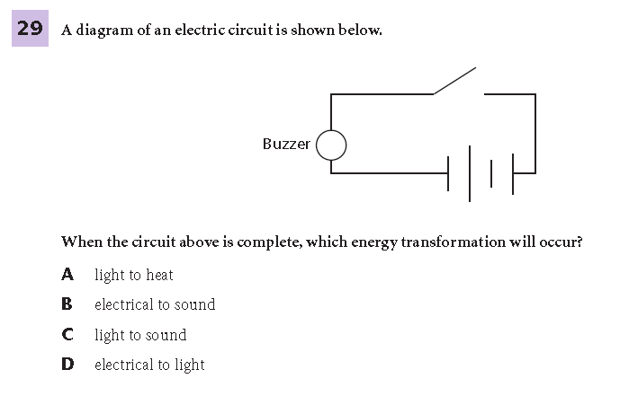
Electrical Conduction 100
Notes:
B

Slide 25
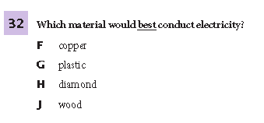
Electrical Conduction 200
Notes:
F

Slide 26
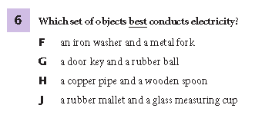
Electrical Conduction 300
Notes:
F

Slide 27
Electrical Conduction 400
Electricity can be conducted by any material
Copper wire is a good insulator of electricity.
Lemon skin is a good insulator of electricity.
Lemon juice is a good conductor of electricity.
Notes:
D

Slide 28
Electrical Conduction 500
an insulator; does not allow electricity to flow.
an insulator; allows electricity to flow.
a conductor; does not allow electricity to flow.
a conductor; allows electricity to flow.
Notes:
D

Slide 29
Questions

