Slide 1
Bell work
What do know about magnetism from electricity and how we use it in our everyday life ?

Slide 2
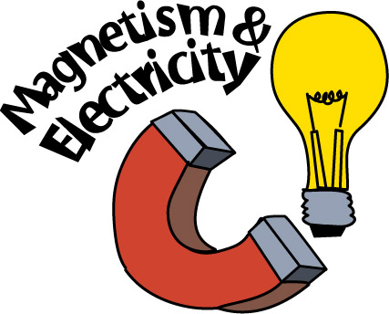
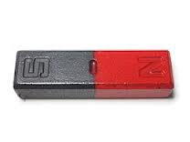
Magnetism from electricity
1st period
Table 4
Anaya martin, mason Harris, and Rinnah Mekonnen

Slide 3
objective
Identify the relationship between electric current and a magnetic field
Compare solenoid, electromagnets, and magnets.
Describe how electromagnetism is involved in the operation of doorbells, electric motors, and galvanometers.

Slide 4
Magnetism from electricity
Most trains roll on wheels on top of a track. Maglev. A maglev train floats because magnetic levitation.
Those train levitate because there are stronger magnets on the cars that are repelled by powerful electromagnetisms in the rails.

Slide 5
the discovery of electromagnetism
Danish physicist Han Christian Oersted discovered the relationship between magnetism electricity and magnetism in 1820.
He held a compass near a wire carrying an electric current. He noticed that when the compass was close to the wire, the compass needle no longer pointed to the north. The result was because a compass needle is a magnet and only moves from its usual north-south orientation when it’s in a magnetic field different from Earth’s magnetic field. After this experiment he concluded that an electric current produces a magnetic field that the direction of the magnetic field depends on the direction of current.

Slide 6
Using electromagnetism
Two devises, the solenoid and the electromagnet, strengthen the magnetic field created by a current-carrying wire. Both devises make electromagnetism more useful for practical applications.
A solenoid is a coil of wire that produces a magnetic field when carrying an electric current.

Slide 7
Solenoids
A single loop of wire carrying a current does not have a very strong magnetic field . If many loops can combine to produce a much stronger magnetic field.
The strength of the magnetic field produced by a solenoid increases as more loops are added and as the current in the wire is increasing.

Slide 8
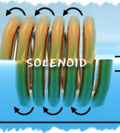
solenoids

Slide 9
Electromagnets
An electromagnet is a magnet that consists of a solenoid wrapped around an iron core.
The magnetic field produced by the solenoid causes the domains inside the iron core to become better aligned.

Slide 10
continued
The magnetic field for the entire electromagnet is the field produced by the solenoid plus the field produced by an electromagnet may be hundreds of time stronger than the magnetic field produced by just by a solenoid with the same number of loops.

Slide 11
Heavy lifting
Electromagnetisms are particularly useful because they can be turned on and off as needed and they are used for heavy lifting.
Electromagnets attract objects containing iron only when a current exists in the wire. where there is no currents in the wire, the electromagnetism
is turned off.

Slide 12
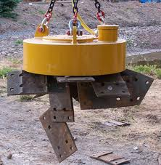
Magnetic heavy lifting
As you can see it only lifts up metal of iron and not any material.

Slide 13
doorbells
Many doorbells contain a solenoid with an iron rod inserted part way in it.
The electric current in the solenoid is controlled by the doorbell button
When you press the button, a switch in the solenoid circuit closes, it is creating an electric current in the solenoid. It produces a magnetic field.
The field pulls the iron rod through the solenoid, and the rod strikes the bell.
Cool web site

Slide 14
doorbell
This is how the doorbell works as the arrows show the steps from the previous slide.

Slide 15
Electric motors
An electric motor is a device that changes electrical energy to kinetic energy.
All electric motors have an armature. An armature is a loop or coil of wire that can rotate. It is mounted between the poles of a permanent magnet or electromagnet.
In electro motors that use direct currents, a device called a commutator is attached to the armature to reverse the direction of the electric current in the wire. A commutator is a ring that spins in half and connected to the ends of the armature.

Slide 16
continued
Electric current enters the armature through brushes that touch the commutator.
Every time the armature and the commutator make a half-turn, the direction of the current is reversed.

Slide 17
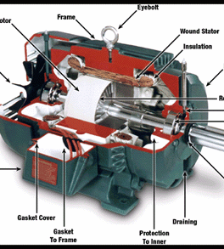
Electric motor
This is not the exact motor that was said at the previous slide.

Slide 18
galvanometer
A galvanometer is a device used to measure current through the interaction of an electromagnet and a permanent magnet.
They are sometimes found in equipment used by electricians, such as ammeters and voltmeters.
Galvanometers contain an electromagnet placed between the poles of a permanent magnet. The electromagnet is free to rotate and is attached to a pointer.
The pointer moves along a scale that shows the size and direction of the current.

Slide 19
continued
when there is a current in the coil of the electromagnet, the poles of the electromagnet are repelled by the poles of the permanent magnet.

Slide 20
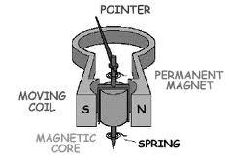
galvanometer
This in not the actual galvanometer as the first picture. This one is a different shape and size.

