Slide 1
Mendelelian Genetics

Slide 2
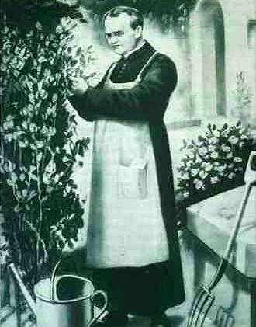
Gregor Mendel (1822-1884)
Responsible for the Laws governing Inheritance of Traits

Slide 3
Gregor Johann Mendel
Austrian monk
Studied the inheritance of traits in pea plants
Developed the laws of inheritance
Mendel's work was not recognized until the turn of the 20th century

Slide 4
Gregor Johann Mendel
Between 1856 and 1863, Mendel cultivated and tested some 28,000 pea plants
He found that the plants' offspring retained traits of the parents
Called the “Father of Genetics"

Slide 5
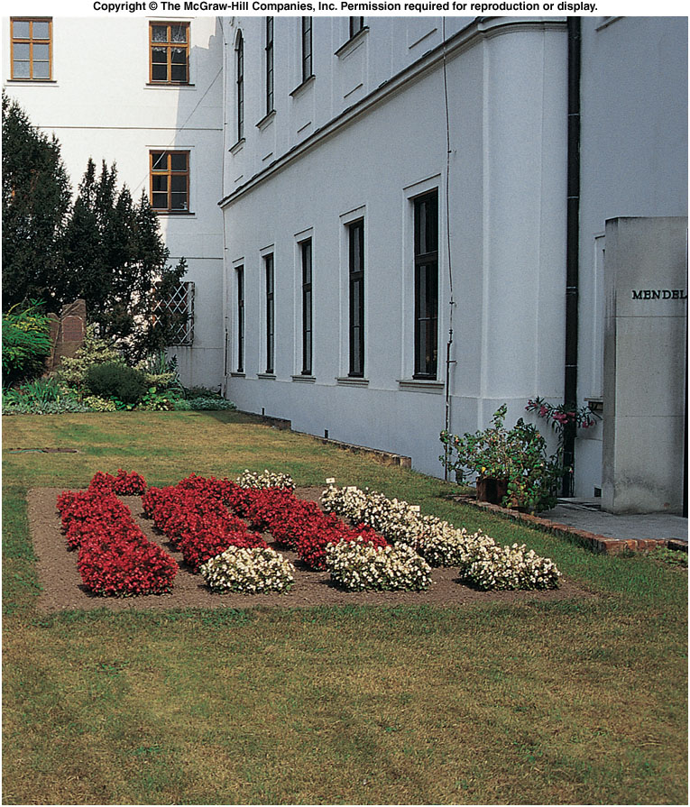
Site of Gregor Mendel’s experimental garden in the Czech Republic
Notes:
Fig. 5.co

Slide 6
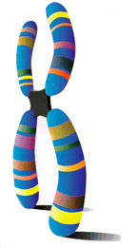
Particulate Inheritance
Mendel stated that physical traits are inherited as “particles”
Mendel did not know that the “particles” were actually Chromosomes & DNA

Slide 7
Genetic Terminology
Trait - any characteristic that can be passed from parent to offspring
Heredity - passing of traits from parent to offspring
Genetics - study of heredity

Slide 8
Use Your Noodle!
Answer the following in your science notebook.
What traits are found in your family?
You have 2 minutes

Slide 9
Types of Genetic Crosses
Monohybrid cross - cross involving a single trait e.g. flower color
Dihybrid cross - cross involving two traits e.g. flower color & plant height

Slide 10
Designer “Genes”
Alleles - two forms of a gene (dominant & recessive)
Dominant - stronger of two genes expressed in the hybrid; represented by a capital letter (R)
Recessive - gene that shows up less often in a cross; represented by a lowercase letter (r)

Slide 11
More Terminology
Genotype - gene combination for a trait (e.g. RR, Rr, rr)
Phenotype - the physical feature resulting from a genotype (e.g. red, white)

Slide 12
Genotype & Phenotype in Flowers
Genotype of alleles: R = red flower r = yellow flower
All genes occur in pairs, so 2 alleles affect a characteristic
Possible combinations are:
Genotypes RR Rr rr
Phenotypes RED RED YELLOW

Slide 13
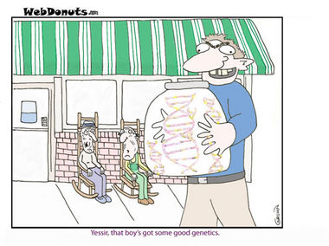
Use Your Noodle!
Answer the following in your science notebook.
Determine which allele is dominate and recessive?
Rr
GG
Hh
ff
You have 2 minutes

Slide 14
Genotypes
Homozygous genotype - gene combination involving 2 dominant or 2 recessive genes (e.g. RR or rr); also called pure
Heterozygous genotype - gene combination of one dominant & one recessive allele (e.g. Rr); also called hybrid

Slide 15
Use Your Noodle!
Answer the following in your science notebook.
Determine which allele is Homozygous or Heterozygous?
Rr
GG
Hh
ff
You have 2 minutes

Slide 16
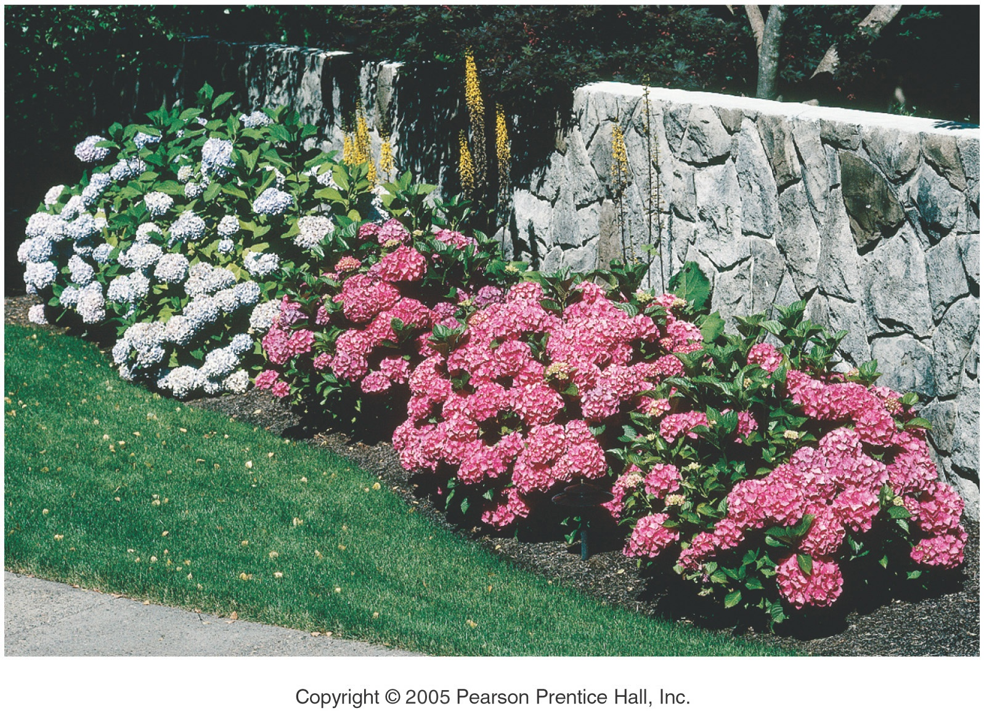
Genes and Environment Determine Characteristics

Slide 17
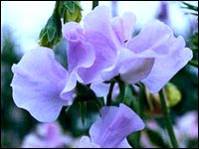
Mendel’s Pea Plant Experiments

Slide 18
Why peas, Pisum sativum?
Can be grown in a small area
Produce lots of offspring
Produce pure plants when allowed to self-pollinate several generations
Can be artificially cross-pollinated

Slide 19
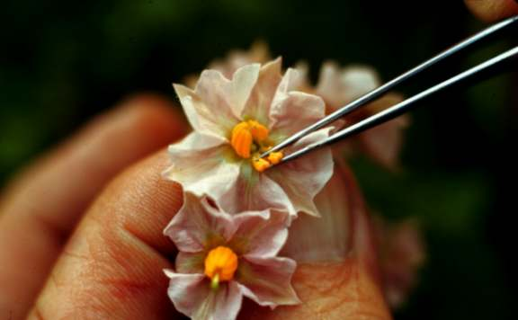
Mendel’s Experimental Methods
Mendel hand-pollinated flowers using a paintbrush
He could snip the stamens to prevent self-pollination
Covered each flower with a cloth bag
He traced traits through the several generations

Slide 20
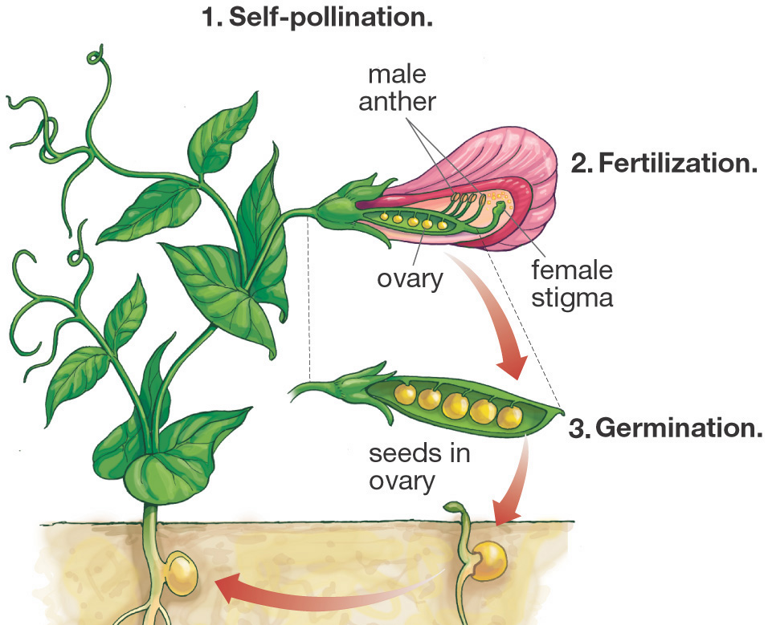
How Mendel Began
Mendel produced pure strains by allowing the plants to self-pollinate for several generations

Slide 21
Eight Pea Plant Traits
Seed shape --- Round (R) or Wrinkled (r)
Seed Color ---- Yellow (Y) or Green (y)
Pod Shape --- Smooth (S) or wrinkled (s)
Pod Color --- Green (G) or Yellow (g)
Seed Coat Color ---Gray (G) or White (g)
Flower position---Axial (A) or Terminal (a)
Plant Height --- Tall (T) or Short (t)
Flower color --- Purple (P) or white (p)

Slide 24
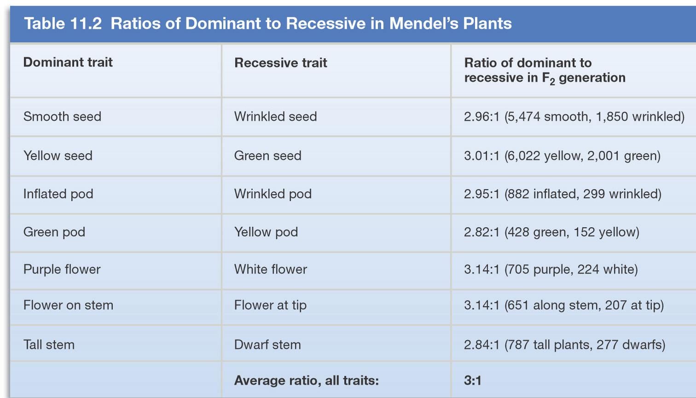
Mendel’s Experimental Results

Slide 25
Following the Generations
Cross 2 Pure Plants TT x tt
Results in all Hybrids Tt
Cross 2 Hybrids get 3 Tall & 1 Short TT, Tt, tt

Slide 26
Punnett Square
Used to help solve genetics problems

Slide 27
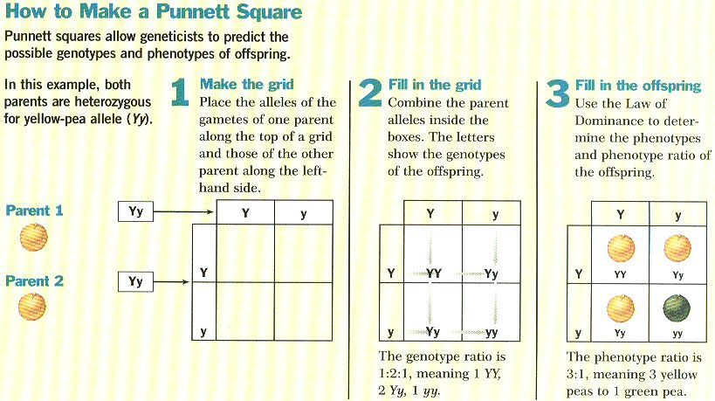

Slide 28
Monohybrid Crosses

Slide 29
P₁ Monohybrid Cross
Trait: Seed Shape
Alleles: R – Round r – Wrinkled
Cross: Round seeds x Wrinkled seeds
RR x rr
Genotype: Rr
Phenotype: Round
Genotypic Ratio: All alike
Phenotypic Ratio: All alike
r
r
R
Rr
Rr
R
Rr
Rr

Slide 30
P₁ Monohybrid Cross Review
Homozygous dominant x Homozygous recessive
Offspring all Heterozygous (hybrids)
Offspring called F₁ generation
Genotypic & Phenotypic ratio is ALL ALIKE

Slide 31
F₁ Monohybrid Cross
Trait: Seed Shape
Alleles: R – Round r – Wrinkled
Cross: Round seeds x Round seeds
Rr x Rr
Genotype: RR, Rr, rr
Phenotype: Round & wrinkled
G.Ratio: 1:2:1
P.Ratio: 3:1
R
r
R
RR
Rr
r
Rr
rr

Slide 32
F₁ Monohybrid Cross Review
Heterozygous x heterozygous
Offspring: 25% Homozygous dominant RR 50% Heterozygous Rr 25% Homozygous Recessive rr
Offspring called F₂ generation
Genotypic ratio is 1:2:1
Phenotypic Ratio is 3:1

Slide 33
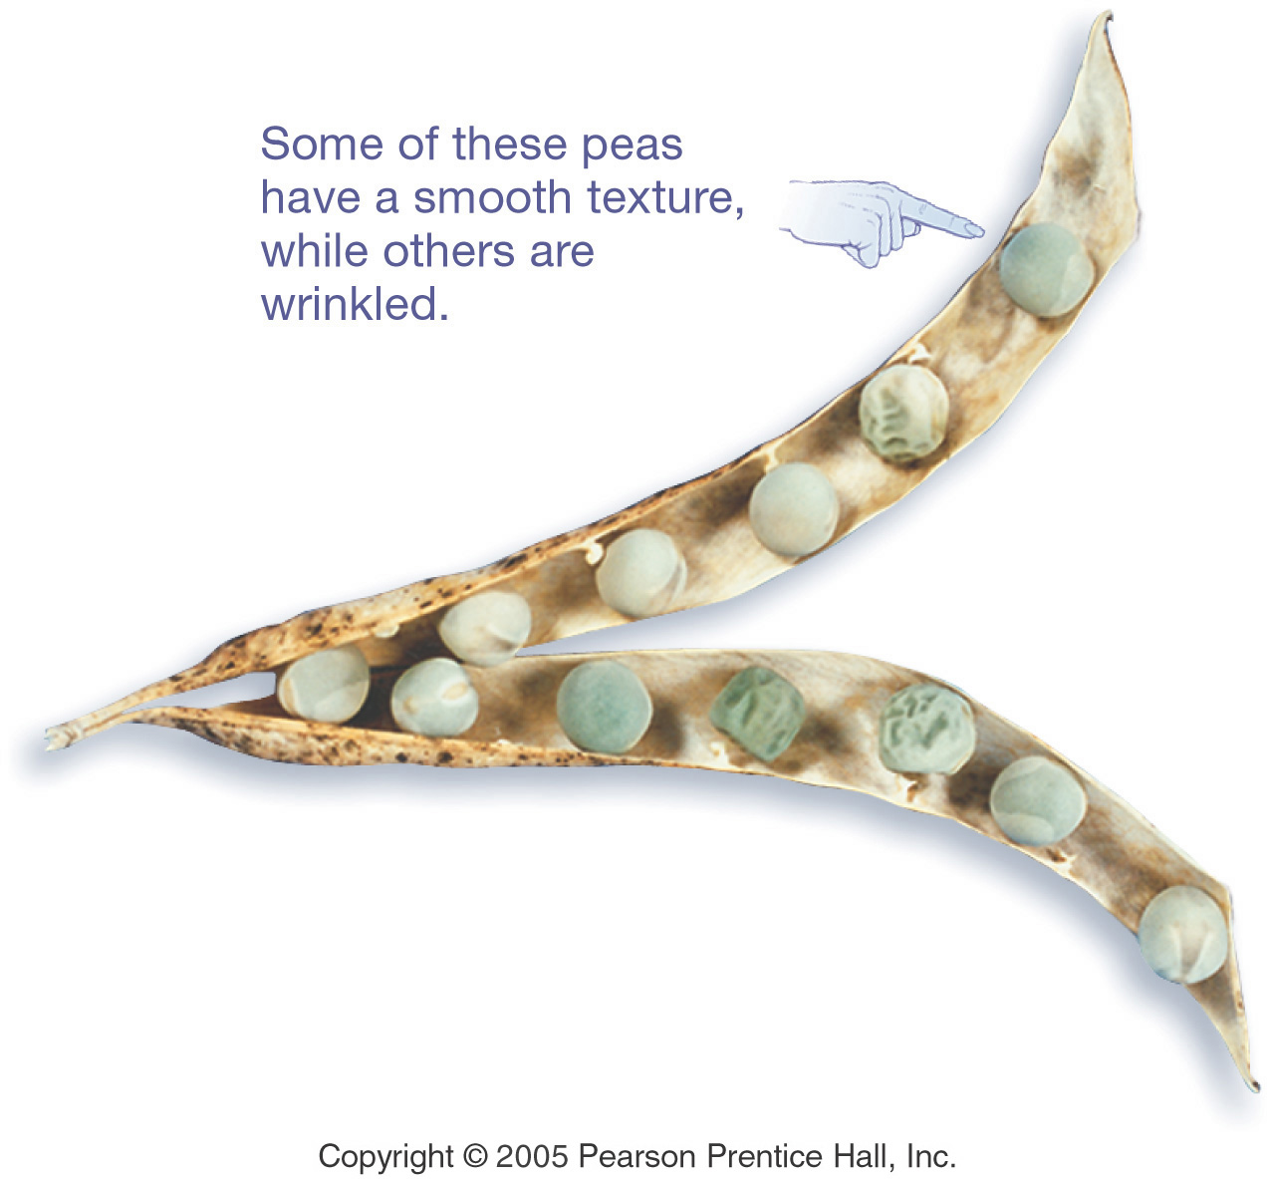
What Do the Peas Look Like?

Slide 34
…And Now the Test Cross
Mendel then crossed a pure & a hybrid from his F₂ generation
This is known as an F₂ or test cross
There are two possible testcrosses: Homozygous dominant x Hybrid Homozygous recessive x Hybrid

Slide 35
F₂ Monohybrid Cross (1st)
Trait: Seed Shape
Alleles: R – Round r – Wrinkled
Cross: Round seeds x Round seeds
RR x Rr
Genotype: RR, Rr
Phenotype: Round
Genotypic Ratio: 1:1
Phenotypic Ratio: All alike
R
r
R
RR
Rr
R
RR
Rr

Slide 36
F₂ Monohybrid Cross (2nd)
Trait: Seed Shape
Alleles: R – Round r – Wrinkled
Cross: Wrinkled seeds x Round seeds
rr x Rr
R
r
Genotype: Rr, rr
Phenotype: Round & Wrinkled
G. Ratio: 1:1
P.Ratio: 1:1
r
Rr
rr
r
Rr
rr

Slide 37
F₂ Monohybrid Cross Review
Homozygous x heterozygous(hybrid)
Offspring: 50% Homozygous RR or rr 50% Heterozygous Rr
Phenotypic Ratio is 1:1
Called Test Cross because the offspring have SAME genotype as parents

Slide 38
Practice Your Crosses
Work the P₁, F₁, and both F₂ Crosses for each of the other Seven Pea Plant Traits

Slide 39
Mendel’s Laws

Slide 40
Results of Monohybrid Crosses
Inheritable factors or genes are responsible for all heritable characteristics
Phenotype is based on Genotype
Each trait is based on two genes, one from the mother and the other from the father
True-breeding individuals are homozygous ( both alleles) are the same

Slide 41
Law of Dominance
In a cross of parents that are pure for contrasting traits, only one form of the trait will appear in the next generation.
All the offspring will be heterozygous and express only the dominant trait.
RR x rr yields all Rr (round seeds)

Slide 42
Law of Dominance

Slide 43
Law of Segregation
During the formation of gametes (eggs or sperm), the two alleles responsible for a trait separate from each other.
Alleles for a trait are then "recombined" at fertilization, producing the genotype for the traits of the offspring.

Slide 44
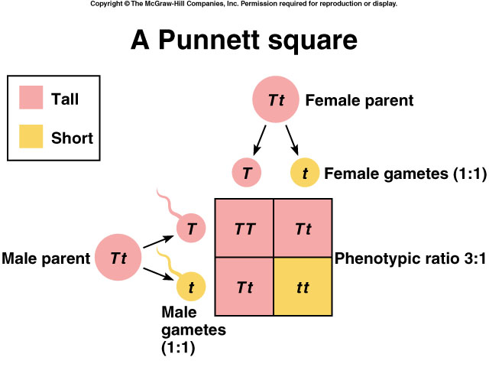
Applying the Law of Segregation

Slide 45
Law of Independent Assortment
Alleles for different traits are distributed to sex cells (& offspring) independently of one another.
This law can be illustrated using dihybrid crosses.

Slide 46
Dihybrid Cross
A breeding experiment that tracks the inheritance of two traits.
Mendel’s “Law of Independent Assortment”
a. Each pair of alleles segregates independently during gamete formation
b. Formula: 2^{n} (n = # of heterozygotes)

Slide 47
Question: How many gametes will be produced for the following allele arrangements?
Remember: 2^{n} (n = # of heterozygotes)
1. RrYy
2. AaBbCCDd
3. MmNnOoPPQQRrssTtQq

Slide 48
Answer:
1. RrYy: 2^{n} = 2² = 4 gametes
RY Ry rY ry
2. AaBbCCDd: 2^{n} = 2³ = 8 gametes
ABCD ABCd AbCD AbCd
aBCD aBCd abCD abCD
3. MmNnOoPPQQRrssTtQq: 2^{n} = 2⁶ = 64 gametes

Slide 49
Dihybrid Cross
Traits: Seed shape & Seed color
Alleles: R round r wrinkled Y yellow y green
RrYy x RrYy
RY Ry rY ry
RY Ry rY ry
All possible gamete combinations

Slide 50
Dihybrid Cross
RY
Ry
rY
ry
RY
Ry
rY
ry

Slide 51
Dihybrid Cross
RY
Ry
rY
ry
RY
Round/Yellow: 9
Round/green: 3
wrinkled/Yellow: 3
wrinkled/green: 1
RRYY
RRYy
RrYY
RrYy
Ry
RRYy
RRyy
RrYy
Rryy
rY
RrYY
RrYy
rrYY
rrYy
ry
RrYy
Rryy
rrYy
rryy
9:3:3:1 phenotypic ratio

Slide 52
Dihybrid Cross
Round/Yellow: 9 Round/green: 3 wrinkled/Yellow: 3 wrinkled/green: 1
9:3:3:1

Slide 53
Test Cross
A mating between an individual of unknown genotype and a homozygous recessive individual.
Example: bbC__ x bbcc
BB = brown eyes
Bb = brown eyes
bb = blue eyes
CC = curly hair
Cc = curly hair
cc = straight hair
bC
b___
bc

Slide 54
Test Cross
Possible results:
bC
b___
C
bC
b___
c
bc
bbCc
bbCc
or
bc
bbCc
bbcc

Slide 55
Summary of Mendel’s laws
LAW
PARENT CROSS
OFFSPRING
DOMINANCE
TT x tt tall x short
100% Tt tall
SEGREGATION
Tt x Tt tall x tall
75% tall 25% short
INDEPENDENT ASSORTMENT
RrGg x RrGg round & green x round & green
9/16 round seeds & green pods 3/16 round seeds & yellow pods 3/16 wrinkled seeds & green pods 1/16 wrinkled seeds & yellow pods

Slide 56
Incomplete Dominance and Codominance

Slide 57
Incomplete Dominance
F1 hybrids have an appearance somewhat in between the phenotypes of the two parental varieties.
Example: snapdragons (flower)
red (RR) x white (rr)
RR = red flower
rr = white flower
r
r
R
R

Slide 58
Incomplete Dominance
r
r
produces the
F₁ generation
R
Rr
Rr
R
Rr
Rr
All Rr = pink
(heterozygous pink)

Slide 59
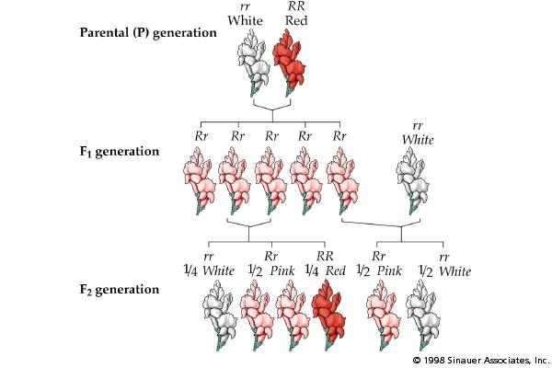
Incomplete Dominance

Slide 60
Codominance
Two alleles are expressed (multiple alleles) in heterozygous individuals.
Example: blood type
1. type A = I^{A}I^{A} or I^{A}i
2. type B = I^{B}I^{B} or I^{B}i
3. type AB = I^{A}I^{B}
4. type O = ii

Slide 61
Codominance Problem
Example: homozygous male Type B (I^{B}I^{B})
x heterozygous female Type A (I^{A}i)
I^{A}
i
I^{A}I^{B}
I^{B}i
I^{B}
1/2 = I^{A}I^{B}
1/2 = I^{B}i
I^{B}
I^{A}I^{B}
I^{B}i

Slide 62
Another Codominance Problem
Example: male Type O (ii) x female type AB (I^{A}I^{B})
I^{A}
I^{B}
i
I^{A}i
I^{B}i
1/2 = I^{A}i
1/2 = I^{B}i
i
I^{A}i
I^{B}i

Slide 63
Codominance
Question: If a boy has a blood type O and his sister has blood type AB, what are the genotypes and phenotypes of their parents?
boy - type O (ii) X girl - type AB (I^{A}I^{B})

Slide 64
Codominance
Answer:
I^{A}
i
I^{B}
I^{A}I^{B}
Parents:
genotypes = I^{A}i and I^{B}i
phenotypes = A and B
i
ii

Slide 65
Sex-linked Traits
Traits (genes) located on the sex chromosomes
Sex chromosomes are X and Y
XX genotype for females
XY genotype for males
Many sex-linked traits carried on X chromosome

Slide 66
Sex-linked Traits
Example: Eye color in fruit flies
Sex Chromosomes
fruit fly
eye color
XX chromosome - female
Xy chromosome - male

Slide 67
Sex-linked Trait Problem
Example: Eye color in fruit flies
(red-eyed male) x (white-eyed female) X^{R}Y x X^{r}X^{r}
Remember: the Y chromosome in males does not carry traits.
RR = red eyed
Rr = red eyed
rr = white eyed
XY = male
XX = female
X^{r}
X^{r}
X^{R}
Y

Slide 68
Sex-linked Trait Solution:
X^{r}
X^{r}
50% red eyed female
50% white eyed male
X^{R}
X^{R} X^{r}
X^{R} X^{r}
Y
X^{r} Y
X^{r} Y

Slide 69
Female Carriers

Slide 70
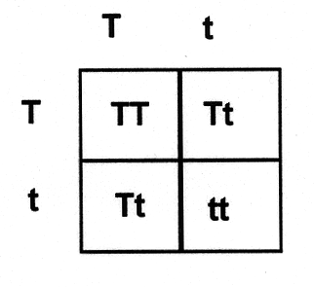
Genetic Practice Problems

Slide 71
Breed the P₁ generation
tall (TT) x dwarf (tt) pea plants
t
t
T
T

Slide 72
Solution:
tall (TT) vs. dwarf (tt) pea plants
t
t
Tt
produces the
F₁ generation
T
Tt
T
Tt
Tt
All Tt = tall
(heterozygous tall)

Slide 73
Breed the F₁ generation
tall (Tt) vs. tall (Tt) pea plants
T
t
T
t

Slide 74
Solution:
tall (Tt) x tall (Tt) pea plants
T
t
produces the
F₂ generation
TT
Tt
T
1/4 (25%) = TT
1/2 (50%) = Tt
1/4 (25%) = tt
t
Tt
tt
1:2:1 genotype
3:1 phenotype

