Slide 1
Atmosphere and Weather

Slide 2
Earth’s Atmosphere
Atmosphere is the gas surrounding Earth (or any planet)
The atmosphere today:
~78% Nitrogen (N₂)
~21% oxygen (O₂)
~1% all other gases
The atmosphere did not always look like this, and was quite different while Earth was young

Slide 3
Earth’s Ancient Atmosphere
Earth’s early atmosphere had little to no gaseous O₂
It was mostly dominated by Hydrogen (H₂)and Helium (H)
Volcanoes began to spew gases like carbon dioxide (CO₂), Ammonia (NH₃), and Methane (CH₄)
This early atmosphere was known as the reduced atmosphere
We know that there was no O₂ because it would have caused the ancient iron rocks to rust, but no rust was found

Slide 4
Development of current atmosphere
Early organisms (plants, protists, bacteria) absorbed the CO₂ and produced O₂ through biochemical cycles
Photosynthesis being the primary one
This also explains why the CO2 content of the current atmosphere is so low
It is now an oxidizing atmosphere

Slide 5
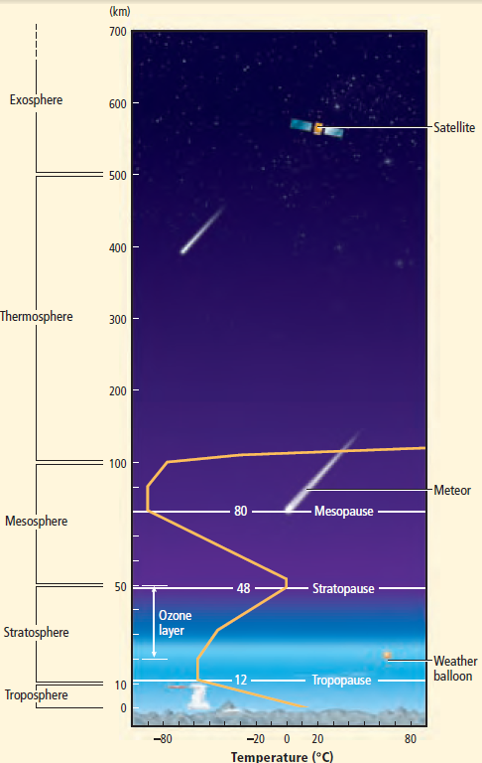
Atmosphere basics
Layers of the atmosphere:
Troposphere
Closest to the ground
Where weather occurs
0-10km above ground
Stratosphere
Contains the ozone later
10-50 km above ground
Mesosphere
50-100 km above ground
Thermosphere
Can be over 1000ºC (1832ºF)
100-500 km above ground
Exosphere
Outer space

Slide 6
Atmosphere and Weather
Weather is the short-term variations in the atmosphere
Caused by 3 main factors:
Temperature
Air Pressure
Humidity

Slide 7
Temperature and Heating Earth
SI unit is degrees Celsius
Water freezes at 0ºC and 32ºf
Water boils at 100ºC and 212ºF
Temperature vs. heat
Temperature is the average amount of molecule movement
Heat is the total amount of molecule movement
Ex. Even though the Atlantic ocean is cold (low temperature), it has so much more mass that it has much more heat contained in it
An oven is very hot to the touch because it has high temperature, but because it’s not as big as the ocean it has FAR less heat

Slide 8
Temperature and Heating Earth
Transfer of heat
Radiation is the transfer of energy through electromagnetic waves
Conduction is transfer of energy through direct contact
Convection is the transfer of energy through moving air or water
As air or water is heated, it rises and the cooler air/water falls, creating loops of moving air/water

Slide 9
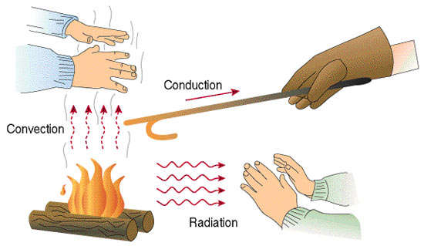
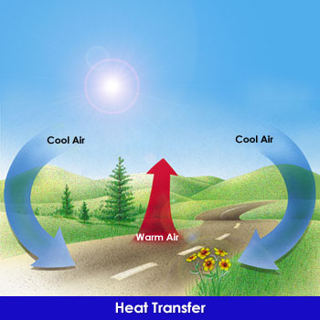
Temperature and Heating Earth

Slide 10
Temperature and Heating Earth
The sun radiating energy to Earth transfers the energy driving weather patterns
This transfer of energy is not equal among all of the earth at all times
Depending on the angle the sun hits a part of the earth, it may transfer a lot of heat or very little
This creates imbalances in the temperatures of different locations, and therefore imbalances of air pressure
The re-balancing of these temperatures and pressures produces weather

Slide 11
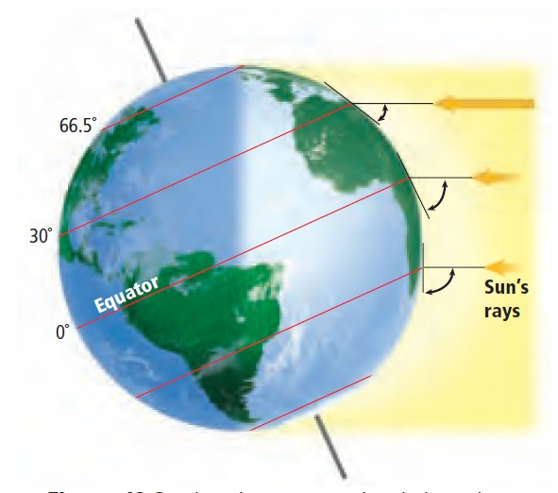
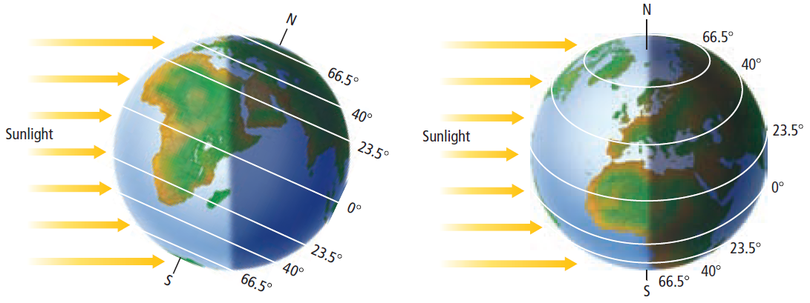
Temperature and Heating Earth
The more direct the sunlight, the more energy is transferred

Slide 12
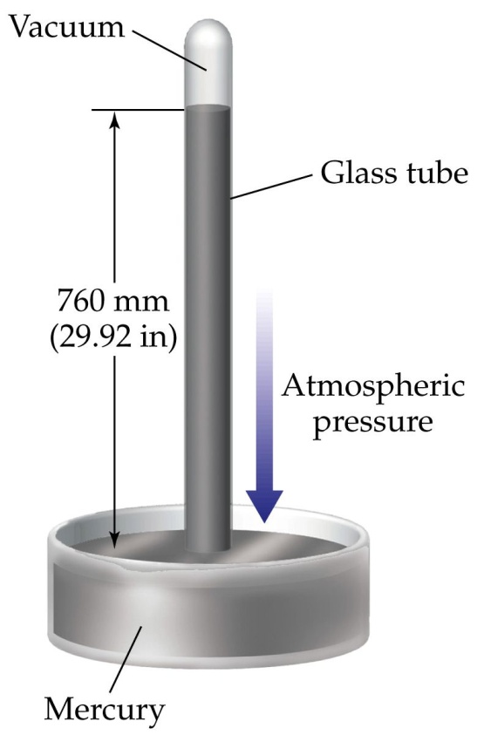
Air Pressure
Differences in air pressure cause wind
Air pressure makes an enormous impact on weather forecasting
The SI unit for air pressure is the Pascal (Pa)
Since these are so tiny, usually air pressure is communicated in millibars. 1 millibar=10 pascals
It is measured using a barometer
Earliest types had atmospheric pressure pushing down on a dish of liquid mercury, which then pushes upward through a tube

Slide 13
Air Pressure
Pressure/temperature/density relationship
The higher the temperature, the less dense things are and the more they expand (ex. roasting marshmallows or hot dogs)
If you have the system closed off (for example, a closed soda bottle), then increasing the heat will also increase the pressure
Because the atmosphere closes off Earth, whenever a part gets heated it increases the pressure in that part

Slide 14
Humidity
This is the amount of water vapor in the atmosphere at a given spot
The air can only hold so much water at a given time
If there’s more water than the air can hold, the air is saturated
More humidity allows for more heat to be transferred through the air
This is why lower temperatures and high humidity feels hotter than “dry heat” with little humidity and higher temperatures

Slide 15
Humidity
When water turns from water vapor back into liquid water, that’s condensation
Warm air can hold more water than cooler air without the water condensing back into liquid
The temperature where the air becomes saturated is the dew point
Condensation in the troposphere creates clouds
The warm air from the surface rises, cools, and condenses high above the ground

Slide 16
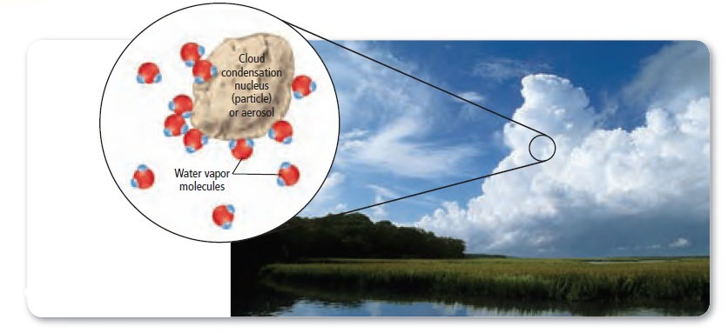
Humidity
The water molecules join around particles in the air like the picture above
When the water condenses from the clouds and falls to the ground it’s called precipitation
Coalescence is when the molecules group up into bigger and bigger droplets/snowflakes/hail pieces
In severe weather the wind can create so much coalescence hailstones the size of baseballs can fall

Slide 17
Humidity

Slide 18
Air Masses and Fronts
Air masses are large volumes of air that share similar temperature, humidity, and pressure
They tend to move around a lot
Because Earth is always spinning, when these masses move they don’t move in straight lines
This curved movement is called the coriolis effect

Slide 19
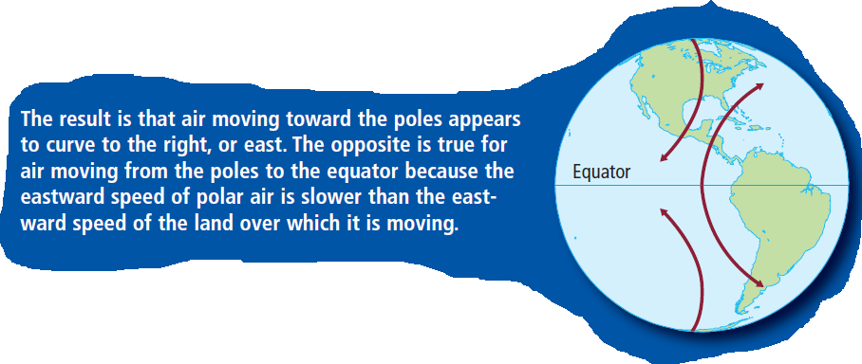
Air Masses and Fronts

Slide 20
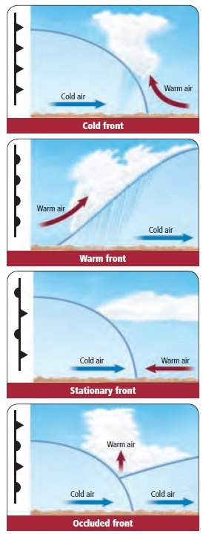
Air Masses and Fronts
When two air masses collide it’s called a front
Whichever mass is moving faster gives the front it’s name
Cold fronts replace warm air with cold air and forces the warm air up
Warm fronts replace cool air with warm air and rise above them
Stationary fronts happen when 2 fronts collide and don’t go anywhere
Occluded fronts push warm air up between 2 cooler air masses

